Slide 1
Machine Learning
Chapter 6. Bayesian Learning
Tom M. Mitchell

Slide 2
Bayesian Learning
Introduction
Bayes Theorem
Bayes Theorem for concept Learning
Bayes optimal classifier
Naive Bayes learner

Slide 3
Introduction
Bayesian reasoning provides a probabilistic approach to inference.
It is based on the assumption that the quantities of interest are governed by probability distributions and optimal decisions can be made by reasoning about these probabilities together with observed data.
It is important to machine learning because it provides a quantitative approach to weighing the evidence supporting alternative hypotheses.

Slide 4
Two Roles for Bayesian Methods
Provides practical learning algorithms:
  Naive Bayes learning: the problem of learning to classify text documents such as electronic news articles.
  Bayesian belief network learning
  Combine prior knowledge (prior probabilities) with observed data
  Requires prior probabilities

Slide 5
Provides useful conceptual framework
  Provides “a standard” for understanding and evaluating other learning algorithms
To determine the conditions under which Find-s, Candidate elimination output most probable hypothesis given training data.
Bayesian analysis is used in neural networks when searching the space of possible neural networks such that sum of squared errors is minimized when learning the target function.
In error function cross entropy

Slide 6
Features of Bayesian Learning Methods
Each observed training example can incrementally decrease or increase the estimated probability that a hypothesis is correct. This provides a more flexible approach to learning than algorithms that completely eliminate a hypothesis if it is found to be inconsistent with any single example.
Prior knowledge can be combined with observed data to determine the final probability of a hypothesis. In Bayesian learning, prior knowledge is provided by asserting (1) a prior probability for each candidate hypothesis, and (2) a probability distribution over observed data for each possible hypothesis.
Bayesian methods can accommodate hypotheses that make probabilistic predictions (e.g., hypotheses such as "this pneumonia patient has a 93% chance of complete recovery").

Slide 7
New instances can be classified by combining the predictions of multiple hypotheses, weighted by their probabilities.
One practical difficulty in applying Bayesian methods is that they typically require initial knowledge of many probabilities.
A second practical difficulty is the significant computational cost required to determine the Bayes optimal hypothesis in the general case

Slide 8
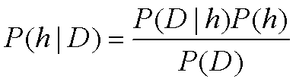
Bayes Theorem
P(h) = prior probability of hypothesis h
P(D) = prior probability of training data D
P(h|D) = probability of h given D
P(D|h) = probability of D given h

Slide 9
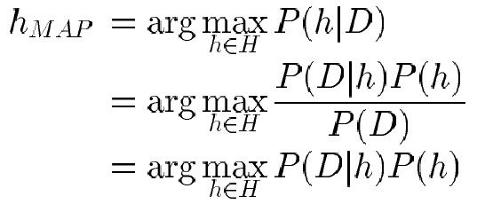
Choosing Hypotheses
Generally want the most probable hypothesis given the training data
Maximum a posteriori hypothesis h_{MAP}:

Slide 10

In some cases, we will assume that every hypothesis in H is equally probable a priori (P(hi) = P(hj) for all hi and hj in H).
In this case we can further simplify the above Equation and need only consider the term P(D/h) to find the most probable hypothesis.
P(D/h) is often called the likelihood of the data D given h, and any hypothesis that maximizes P(D/h) is called a maximum likelihood (ML) hypothesis,

Slide 11


Bayes Theorem
Does patient have cancer or not?
A patient takes a lab test and the result comes positive or negative. The test returns a correct positive result in only 98% of the cases in which the disease is actually present, and a correct negative result in only 97% of the cases in which the disease is not present. Furthermore, .008 of the entire population have this cancer.
Suppose we now observe a new patient for whom the lab test return a positive result. Should we diagnose the patient as having cancer or not? The maximum a posteriori hypothesis can be found using Equation

Slide 12
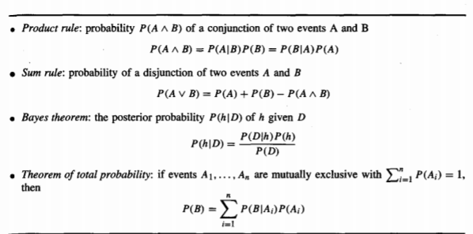
Basic Formulas for Probabilities

Slide 13
BAYES THEOREM AND CONCEPT LEARNING
What is the relationship between Bayes theorem and the problem of concept learning?
Since Bayes theorem provides a principled way to calculate the posterior probability of each hypothesis given the training data, we can use it as the basis for a straightforward learning algorithm that calculates the probability for each possible hypothesis, then outputs the most probable.

Slide 14
Relation to Concept Learning(1/2)
Consider our usual concept learning task
  instance space X, hypothesis space H, training
  examples D
  consider the FindS learning algorithm (outputs most specific hypothesis from the version space V S_{H,D})
What would Bayes rule produce as the MAP hypothesis?
Does FindS output a MAP hypothesis??

Slide 15

Brute Force MAP Hypothesis Learner
For each hypothesis h in H, calculate the posterior probability
Output the hypothesis h_{MAP} with the highest posterior probability

Slide 16
In order specify a Learning problem for the BRUTE- FORCE MAP LEARNING algorithm we must specify what values are to be used for P(h) and for P(D/h).
(P(D) will be determined once we choose the other two).
We may choose the probability distributions P(h) and P(D/h) in any way we wish, to describe our prior knowledge about the learning task.
Here let us choose them to be consistent with the following assumptions:
1. The training data D is noise free (i.e., di = c(xi)).
2. The target concept c is contained in the hypothesis space H .
3. We have no a priori reason to believe that any hypothesis is more probable than any other.

Slide 17


Given no prior knowledge that one hypothesis is more likely than another, it is reasonable to assign the same prior probability to every hypothesis h in H.
Furthermore, because we assume the target concept is contained in H we should require that these prior probabilities sum to 1.
Together these constraints imply that we should choose

Slide 18


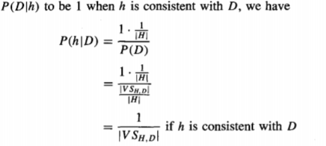
P(D/h) to be 0 when h is inconsistent with D,

Slide 19
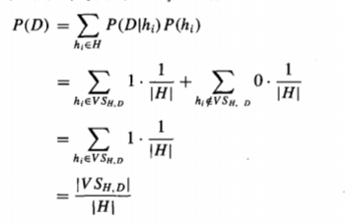
Let us calculate P(D)

Slide 20
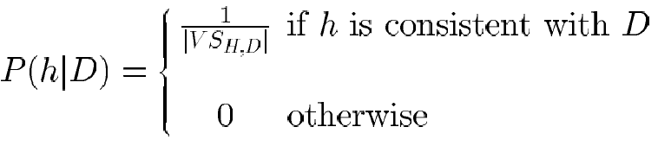
Relation to Concept Learning
Assume fixed set of instances <x₁,…, x_{m}>
Assume D is the set of classifications: D = <c(x₁),…,c(x_{m})>
Choose P(D|h):
  P(D|h) = 1 if h consistent with D
  P(D|h) = 0 otherwise
Choose P(h) to be uniform distribution
  P(h) = 1/|H| for all h in H
Then,

Slide 21
The above analysis implies that under our choice for P(h) and P(D/h), every consistent hypothesis has posterior probability (1 /I V S,H I), and every inconsistent hypothesis has posterior probability 0.
Every consistent hypothesis is,there fore, a MAP hypothesis.

Slide 22
MAP hypothesis and consistent Learner
A learning algorithm is a consistent learner provided it outputs a hypothesis that commits zero errors over the training examples.
Every consistent learner outputs a MAP hypothesis, if we assume a uniform prior probability distribution over H (i.e., P(hi) = P(hj) for all i, j), and if we assume deterministic, noise free training data (i.e., P(D/h) = 1 if D and h are consistent, and 0 otherwise).

Slide 23
FIND-S searches the hypothesis space H from specific to general hypotheses, outputting a maximally specific consistent hypothesis (a maximally specific member of the version space).
Because FIND-S outputs a consistent hypothesis, it will output a MAP hypothesis under the probability distributions P(h) and P(D/h) defined above.
Of course FIND-S does not explicitly manipulate probabilities at all-it simply outputs a maximally specific member

Slide 24
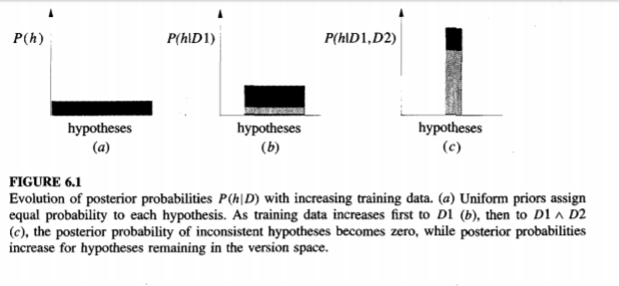

Slide 25
Find-S gives maximally specific hypothesis from the version space, its output hypothesis is MAP hypothesis relative to any probability distribution that favors more specific hypothesis.
Any probability distribution that assigns P(h1)>=p(h2)if h1 is more specific than h2.then find-s outputs a MAP hypothesis.
Like this Bayesian learning characterizes the behavior of learning algorithms.

Slide 26
P(h) and P(D/h) are the implicit assumptions in Bayesian learning. This is inductive bias here is based on the model probabilistic reasoning.

Slide 27
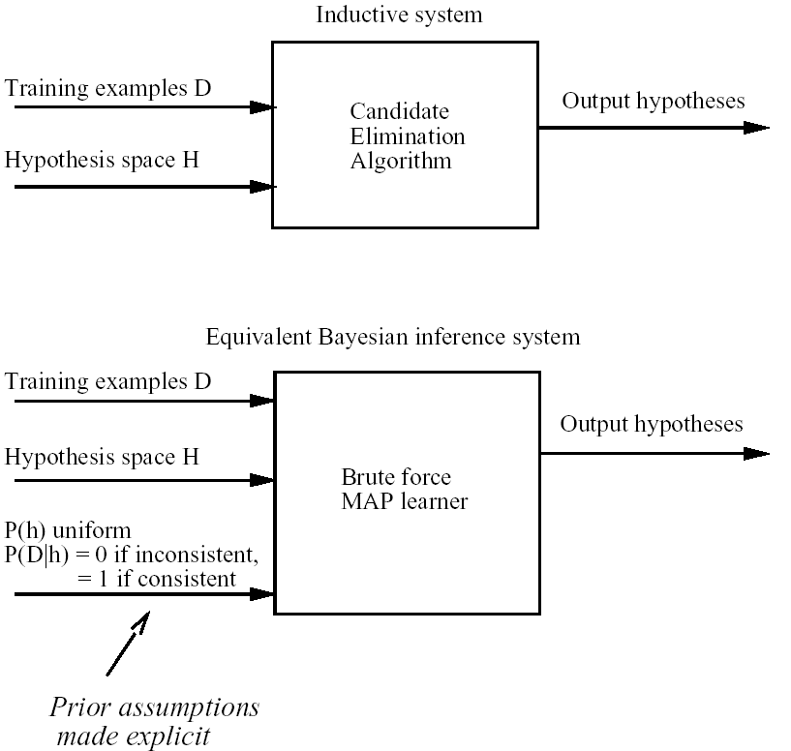
Characterizing Learning Algorithms by Equivalent MAP Learners

Slide 28
Bayes Optimal Classifier
Most Probable Classification of New Instances
So far we’ve sought the most probable hypothesis given the data D (i.e., h_{MAP})
Given new instance x, what is its most probable classification?
  h_{MAP}(x) is not the most probable classification!
Consider:
  Three possible hypotheses:
P(h₁|D) = .4, P(h₂|D) = .3, P(h₃|D) = .3
  Given new instance x,
h₁(x) = +, h₂(x) = −, h₃(x) = −
  What’s most probable classification of x?

Slide 29

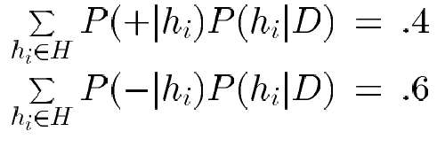

Bayes Optimal Classifier
Bayes optimal classification:
Example:
P(h₁|D) = .4, P(−|h₁) = 0, P(+|h₁) = 1
P(h₂|D) = .3, P(−|h₂) = 1, P(+|h₂) = 0
P(h₃|D) = .3, P(−|h₃) = 1, P(+|h₃) = 0
therefore
and

Slide 30
Gibbs Classifier
Bayes optimal classifier provides best result, but can be expensive if many hypotheses.
Gibbs algorithm:
  1. Choose one hypothesis at random, according to P(h|D)
  2. Use this to classify new instance
Surprising fact: Assume target concepts are drawn at random from H according to priors on H. Then:
E[error_{Gibbs}] ≤ 2E [error_{BayesOptional}]
Suppose correct, uniform prior distribution over H, then
  Pick any hypothesis from VS, with uniform probability
  Its expected error no worse than twice Bayes optimal

Slide 31
Naive Bayes Classifier (1/2)
Along with decision trees, neural networks, nearest neighbor, one of the most practical learning methods.
When to use
  Moderate or large training set available
  Attributes that describe instances are conditionally independent given classification(on the class label attribute)
Successful applications:
  Diagnosis
  Classifying text documents

Slide 32
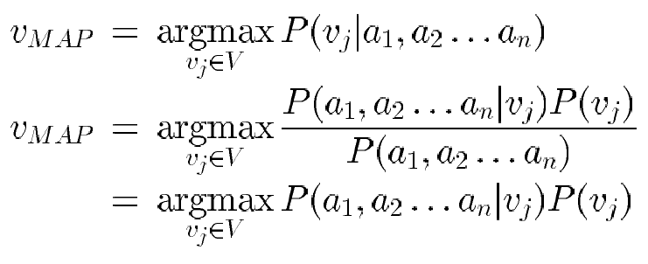


Naive Bayes Classifier (2/2)
Assume target function f : X → V, where each instance x described by attributes <a₁, a₂ … a_{n}>.
Most probable value of f(x) is:
Naive Bayes assumption:
which gives
Naive Bayes classifier:

Slide 33

Naive Bayes Algorithm
Naive Bayes Learn(examples)
For each target value v_{j}
P(v_{j}) ← estimate P(v_{j})
For each attribute value a_{i} of each attribute a
P(a_{i} |v_{j}) ← estimate P(a_{i} |v_{j})
Classify New Instance(x)
^
^

Slide 34

Naive Bayes: Example
Consider PlayTennis again, and new instance
<Outlk = sun, Temp = cool, Humid = high, Wind = strong>
Want to compute:
P(y) P(sun|y) P(cool|y) P(high|y) P(strong|y) = .005
P(n) P(sun|n) P(cool|n) P(high|n) P(strong|n) = .021
→ v_{NB} = n

Slide 35


Naive Bayes: Remarks (1/2)
1. Conditional independence assumption is often violated
  ...but it works surprisingly well anyway.
  Note: don’t need estimated posteriors to be correct; need only that
  Naive Bayes posteriors often close to 1 or 0

Slide 36
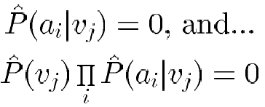
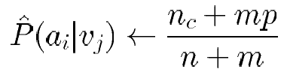

Naive Bayes: Remarks (2/2)
2. what if none of the training instances with target value v_{j} have attribute value a_{i}? Then
Typical solution is Bayesian estimate for
where
  n is number of training examples for which v = v_{i},
  n_{c} number of examples for which v = v_{j} and a = a_{i}
  p is prior estimate for
  p=1/k Where k is domain size of the input attribute
  m is weight given to prior
  (i.e. number of “virtual” examples)
  .

